Slide 1

Agile Team Facilitator Overview
Q42014
Small & Fernstrom

Slide 2
Welcome!
Learning Objectives – Upon completing this class, you’ll be able to:
Describe Agile values and principles from the ATF’s point of view
Describe the ATF’s responsibilities in agile practices
Explain the difference between the ATF and nearby roles and how they work together
Find additional training and learning resources
Apply the learning from the class and workshop in your day-to-day work as an ATF

Slide 3


Introductions
Your boss told you
You’ll get training credits
Or? -- Tell us!
Introduce yourself by sharing something about
Your work
Personal life (incl. a fun fact)
Why you are here

Slide 4
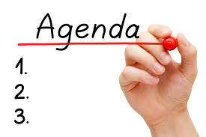
1:00 – 2:00 pm Chartering
2:10 – 3:00 pm The ATF’s Role & Responsibilities (R&R)
3:10 – 4:00 pm Agile Values - Principles & the ATF
4:10 – 5:00 pm ATF Partnerships & The Agile Life Cycle
Next Day:
8:00 – 9:00 am “Agile Patterns & Anti-Patterns”
9:10 – 10:00 am Words of Wisdom from a Pro
10:10 – 11:00 am Debrief for Agile Patterns & Anti-Patterns
1:10 – 12:00 am Resources & Wrap Up

Slide 5
What’s Our Working Agreement?
A Working Agreement defines the specific rules or norms that the team chooses to adopt to assure their effectiveness
For example:
Be present, engaged
Participate
No multitasking
What else will make this training effective and efficient?
Notes:
The working agreement is a way to make the success of the class (or the project) a shared responsibility.
This is our “contract” for how we work together towards that end.
It is not the facilitator’s or instructor’s job to enforce the agreement – it is everyone’s responsibility.
Periodically, the working agreement should be reviewed and updated according to the team’s needs

Slide 6
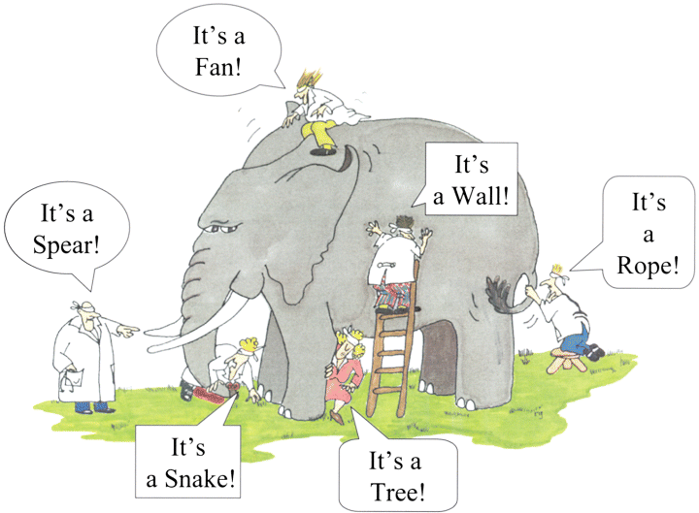
What’s Your View on Agile?
Notes:
Agile development has been around for many years and there are many conceptions and misconceptions about – please share your perspective – what is agile?

Slide 7
ATF: The Most Important Thing…
Be a role model for agility and coach members of the team to be more agile

Slide 8
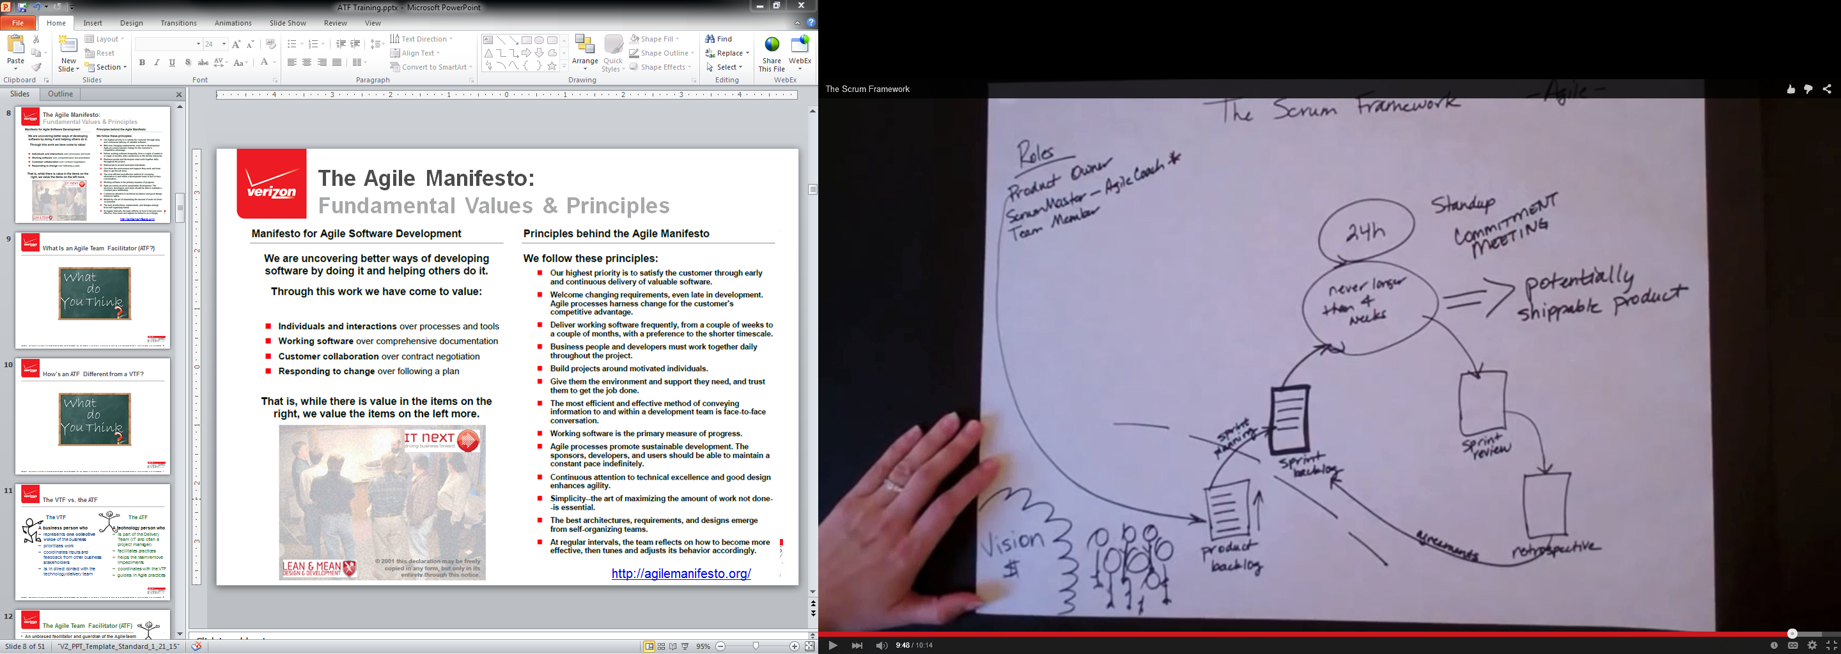
What Is The Agile Framework?
VTF
DTP
ATF
Sprint → Iteration

Slide 9
What’s In A Name? “Value” Stakeholders & Activities
Value Team – Stakeholders who bring “requirements” to the delivery team [Verizon]
Value Management – Customer-focused practices to maximize value delivery [ICAgile]
Value Stream – System definitions, development, and deployment steps used to provide a continuous flow of value to the business, customer, or end user [SAFe]
Value Team Facilitator – The single voice of the value team who sets priority, clarifies user stories, and gives feedback to the delivery team [Verizon]
Product Owner – Scrum term most equivalent to VTF; the VTF role emphasizes the collaborative nature of requirements gathering
Business Unit
Business Unit
Business Unit
Value-Team
Value-Team Facilitator
Delivery Team
Business Unit
Business Unit
Business Unit
End User or Customer
←→
VES Sales & Account Teams
←→
VES Product Manager
←→
VTF & Value Team
←→
Delivery Team
Who is “the business” in this value chain?

Slide 10
What’s in a Name? “Delivery” Stakeholders & Activities
Delivery (or Agile) Team – The analysts, developers, testers, and other SMEs in IT or engineering who are responsible for delivering value according to the VTF’s priorities
Agile Team Facilitator (ATF) – The role that facilitates the agile practices used by the delivery team. It might be one person or some practices could be facilitated by any member of the delivery team, especially on a rotating basis – e.g., demonstrations or iteration planning
Scrum Master – Equivalent to ATF [Scrum]
Iteration – A time-box used by the delivery team for creating working software to implement user stories; two weeks is considered the ideal length
Sprint – Equivalent to iteration [Scrum]
Daily Touch Point (DTP) – A daily, 15-minute time box for the team to set daily goals and identify impediments
Daily Standup or Daily Scrum – Equivalent to DTP [Scrum]
Application
Application
Value-Team
Delivery Team
Agile-Team Facilitator
Application
Application

Slide 11
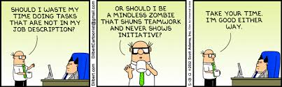
The ATF’s Role & Responsibilities

Slide 12
The Agile Team Facilitator (ATF)
An unbiased facilitator and guardian of the Agile team practices - At the most basic, the purpose of an Agile Team Facilitator is to facilitate the Agile practices, foster collaboration amongst team members, and generally support a self-organized team.
An ATF provides group facilitation tools and techniques for effectively designing meetings and workshops that both engage the entire audience and drive towards agreed-upon outcomes.
Agile Team Facilitators behave in ways consistent with Agile and are Agile role models. This includes becoming aware of, and growing into, the embodiment of Agile that one expects from an Agile Coach: namely, embracing servant leadership and displaying the behaviors that come with key mindset shifts

Slide 13
Characteristics of VTFs & ATFs – 1
 | VTF | ATF
Passionate about the domain | ü | ü
Knows the customers – many of them | ü
Knows the development community |  | ü
Is not too close to a single customer | ü
Has business experience in the domain | ü
Has IT experience and understand the SDLC |  | ü
Doesn’t think he/she knows more about the market than he/she really does | ü
Doesn’t think s/he knows the answers to all of the questions |  | ü
Great communicator, negotiator, leader and facilitator | ü | ü
Works and plays well with others | ü | ü
Can speak intelligently about the issues | ü | ü

Slide 14
Characteristics of VTFs & ATFs – 2
 | VTF | ATF
Has willingness to learn – from everyone | ü | ü
Is willing to make hard decisions about scope | ü
Is willing to accept hard decisions about scope |  | ü
Can say “No” | ü | ü
Keeps his/her promises | ü | ü
Defends the team’s ability to produce the product | ü | ü
Treats all the value and delivery team as knowledgeable professionals | ü | ü
Sets reasonable performance expectations | ü | ü
Servant Leader | ü | ü

Slide 15

Who Will Be The ATF?
The ATF must have a good understanding of the agile practices and how to facilitate them
Each project in VES will start with an assigned ATF from IT; it could be anyone on the delivery team
Ideally, the role of ATF will become a shared, rotating responsibility so that everyone gets a turn to facilitate the practices; teams might discuss this at chartering or re-charting
The ATF cannot also be the VTF

Slide 16

The ATF
…is part:
Practice Facilitator – understands the expected outcomes of each practice and adjusts the design of the practice according to the needs of the situation
Coach/Mentor/Trainer – Teach teams and team members about agile practices and their expected outcomes and outputs
Bulldozer – removes impediments (or asks for help)
Image Credit: http://shopping-tyrol.at/wp-content/uploads/2014/07/6372917497_67254b5e80_z.jpg

Slide 17
What’s Different?
Responsibility | Project Manager | Agile Team Facilitator
Understand customer need | Up front and discontinuous | Constant interaction with VTF
Document requirements | Fully elaborated in documents. Hand off. | We value working software over comprehensive documentation; embraces progressive elaboration;
Scheduling | Plan a one time delivery at the end | Helps delivery team develops valuable software iteratively and deliver value incrementally
Prioritize requirements | Not at all or one time only | Helps delivery team respond to changing requirements; advises VTF on what is possible
Validate requirements | Not applicable. QA responsibility | Solicits feedback from VTF at demonstrations and whenever possible
Manage change | Prohibit change – weekly CCB meetings | Helps team enforce iteration boundaries and short time boxes
Leadership | Control | Acts as servant leader to help the team continue to improve its performance

Slide 18
Responsibilities of an ATF
Teach agile practices when they are either new to the team or to team members
Facilitate agile practices
Remove impediments (or ask for help when needed)
Be a servant leader to help the team continue to improve its performance
Be mindful of maintaining a safe environment where all ideas are welcome and all members are respected for their contributions to the team’s work
Help the team make decisions by consensus
Ensure full participation of all team members
Create a culture of empowerment on the team – they own their process and the “product” they are creating
Continued …
Notes:
Represent the business stakeholders’ interests. Taking the middle person out, allowing the business to communicate directly to the IT team. Be the voice of the business throughout all project activities. There could be competing interests among the business representatives, therefore the VTF’s role is many times to coordinate and negotiate.
Take ownership of the business needs and requirements and make ultimate decisions on what gets built and when.
Owning the prioritizing and grooming of the Product Backlog
Analyze stakeholder needs and collaborate with IT team to plan solutions and clarify requirements.
Collaborate with the CAM [when available] and/or IT lead(s) [ex. tech leads] to coordinate and make visible project schedules and team member availability / staffing.
This is not about the administrative aspect, but more about the collaboration aspect.
Business person will be able to see what is really going on with the project. (visibility)
Maintain subject matter expertise in the project’s domain and coordinate with the core team.
Effectively communicate with the IT team so that they can provide work estimates and accept and complete work to the satisfaction of the stakeholders
Actively participating in the ceremonies, especially in Chartering and in Retrospectives
Effectively communicate back to the business stakeholders.
On a regular basis to provide feedback on progress of implementation. (inward and outward)
In conjunction with others on the project, manage project risk and resolve project issues.
Verify the functionality and quality of the product through various means including but not limited to end-user acceptance testing.

Slide 19
ATF Responsibilities, Cont’d.
Ensure the team only works on the iteration backlog, not “special requests”
Help the team radiate their status to all stakeholders
Collaborates with Delivery Team on project schedules
Partner with VTF to maintain close coordination between the value team and the delivery team
Celebrate the team’s successes
Help the team to inspect its current ways of working and improve its performance

Slide 20
That was a great meeting!
Agile → team work
Team work → meetings
Meetings must be productive
Meeting Participant’s Bill of Rights
As a meeting participant, I want…
To know the meeting’s purpose, agenda, and roles/responsibilities
To be sure the right people are in the meeting
To know that the meeting has value for me
To know the scope of authority
The meeting to start and end on time
To keep on topic for the meeting’s purpose and agenda
See something so I can stay focused
To feel like my time was productively used
Everyone to be heard and no one dominates the discussion
To know how we are going to make decisions
The meeting to end with clear outcomes
What else?

Slide 21
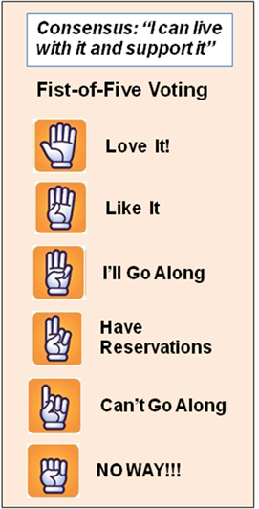
Meeting Facilitator’s Tricks and Tips, Cont’d.
Design the meeting for all to participate; do not let any one(s) dominate the meeting
At the meeting start, ask permission to use a parking lot and agreement to a “communication plan” with one email from the group to other stakeholders after the meeting with results and outcomes
Make group decisions by consensus whenever possible
Use the ELMO (enough, let’s move on) rule

Slide 22

The ATF Has a Big Job; Please Share It
In less complex situations there will be one team with one ATF
If it gets more complex, there might be multiple sub-teams, each with its own ATF – remember, they are all still one team
The facilitator of agile practices can be a shared, rotating responsibility – each person might take a turn leading a practice; e.g., DTPs, iteration planning, demonstrations, retrospectives
Sub-team
Sub-team
Notes:
As Henrik Kniberg says in his video:
“What if we have a larger project with multiple teams? Instead of one team with 5 people here, we might have 3 teams. And we might have several product owners, each with their own backlog for a different part of the product.
Overall, the model is really the same. We still need capacity management, we still need stakeholder communication, we still need product owners who can say No, we still need backlog grooming. Velocity is the sum of all output, and can be used for forecasting. Or make a separate forecast for each team, if that makes more sense.
In a multi team scenario, however, the POs have an important additional responsibility – to talk to each other! We should organize the teams and backlogs to minimize dependencies. But there will always be SOME dependencies. So there needs to be some kind of sync between the product owners so that we build things in a sensible order, and avoid sub optimization. In large projects, this usually calls for some kind of Chief Product Owner role to keep the product owners synchronized.”

Slide 23
What are the Roles for Agile Stewardship?
Enterprise Agile Coach
Agile Coach
Agile Team Facilitator
Agile coach with advanced skills
Systems coaching
Organizational development
Culture, change management, and leadership
Scope – works at all levels in an organization to help organization use Agile as strategic asset for business value generation, which often includes culture change
ATF with high-level of knowledge:
Lean/Agile practices
One or more knowledge domains (technical, business, etc.)
Developed some coaching skills
Significant level of skill in facilitation, mentoring, training
Scope – multi-team, starting up new teams, mentoring and looking out toward the wider organization
Agile Team Facilitator
Developing basic skills:
Facilitation
Mentoring or training
Conscious communication
Scope – one or two Agile teams
Source: IC Agile, Agile Team Facilitation & Coaching Track

Slide 24


Path for Growth
Agile/Lean Fundamentals
Facilitation
Coaching
History & Mindset
Individuals & Interactions
Value-driven Development
Customer & User Involvement
Planning & Adapting
The Agile Coach Roles
Coach as Facilitator
Skillfully facilitating the Agile practices
Coach as a professional coach
Coach as mentor
Coach as teacher
Teams
ICAgile Fundamentals earning Objectives:
https://www.icagile.com/files/2014.AgileFundamentals.pdf
ICAgile Coaching Learning Objectives:
https://icagile.org/files/2014.AgileCoaching.pdf

Slide 25
Agile Values & Principles and the ATF

Slide 26
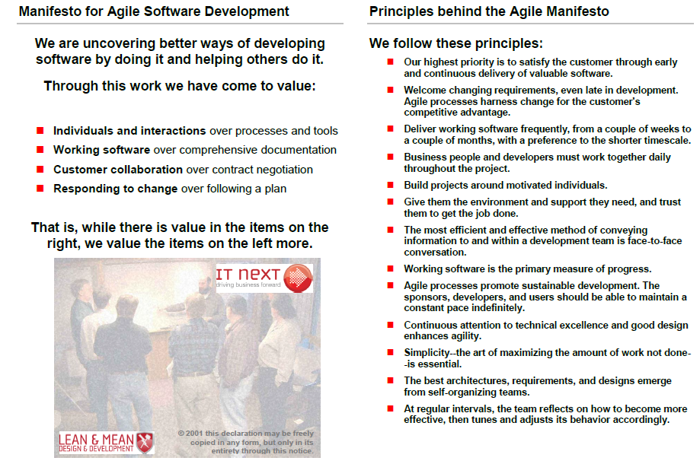
The Agile Manifesto: Fundamental Values & Principles
http://agilemanifesto.org/

Slide 27



Activity: Agile Values & Principles for the ATF
Set Up 4 minutes
Self-organize into teams of 2-3 people
Each team will pick one value and one principle from the Agile Manifesto
Discuss 10 minutes
Each team will discuss why or how this item is important from the ATF’s perspective, what the ATF needs to consider and do based on the selected value and principle.
Share 2-3 minutes each
Each team will present its insights for class discussion

Slide 28
Debrief – Agile Values & Principles
Why or how is the value/principle your team picked important from the ATF’s perspective?
Each team presents their findings to the class
2 - 3 minutes per team

Slide 29

VTF Partnerships – It’s a Team
ATF & VTF
ATF & Delivery Team
ATF & Managers of Team Members
ATF & Other Stakeholders
Image Credit: http://www.lumaxart.com/

Slide 30
The ATF & the VTF
The ATF
The VTF
A technology person who
is part of the Delivery Team (IT and often a project manager)
facilitates practices
helps the team remove impediments
Partners with the VTF to ensure coordination
A business person who
represents one collective voice of the business
prioritizes work
coordinates inputs and feedback from other business stakeholders
is in direct contact with the technology/delivery team
These roles require a strong partnership
Notes:
The VTF establishes the vision
Manages the return on investment (ROI)
Build the right system/product in the right sequence
Call for Releases
Write Stories (Product Backlog Items)
Show up at critical events

Slide 31
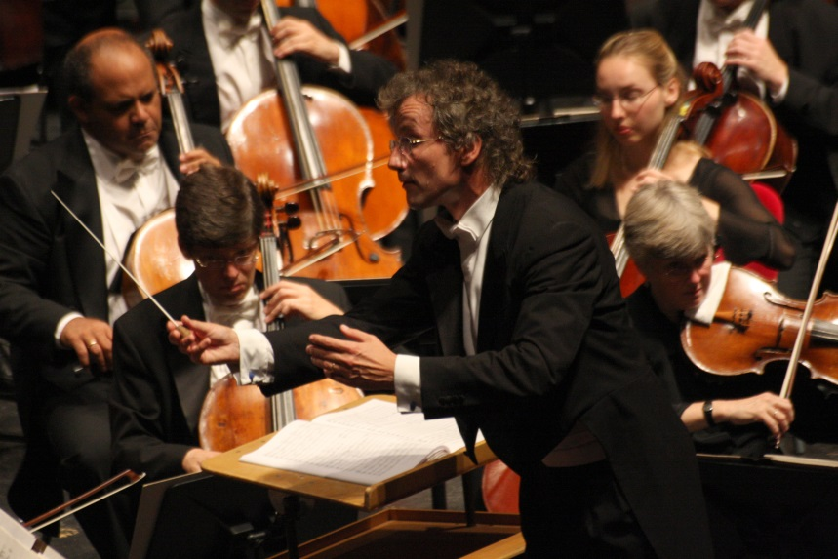
ATF & The Delivery Team
The ATF is a servant leader for the delivery team; her job is to help them be successful and continue to improve their performance
Teaches agile practices to the team or individuals, as needed
Facilitates the practices to ensure they produce desired outcomes and outputs
Removes impediments (or asks for help, as needed)
Radiates information to other stakeholders
Celebrates the team’s accomplishments
Image credit: https://en.wikipedia.org/wiki/ File:Franz_Welser-M%C3%B6st_2.jpg
You cannot tell people what to do and expect to get committed behavior

Slide 32
The ATF & the Managers of the Delivery Team Members
Meets with the managers of the delivery team members before the project to ask for their support in encouraging their folks to be “all in” and address any concerns
Relies on managers to address team impediments and personnel issues
Provides feedback to managers as part of a 360-degree evaluation process
Managers can make-or-break any transformation or change initiative

Slide 33
The ATF & Other Stakeholders
Stakeholders around the organization will want to know how the work is going and the team is maturing
The ATF radiates this information and celebrates the team’s accomplishments
When there are impediments to be removed, the ATF is the first line of defense and should ask for help whenever needed
Think of the stakeholders as resources to draw on when needed and not as obstacles to be avoided

Slide 34


The Proxy VTF
Proxy VTF Responsibilities
Performs VTF responsibilities on behalf of the VTF
Supports the VTF in creating roadmap and product backlog
Proxy for the VTF and decision point for the team
Tests the functionality, quality of the product, UAT
Provides continuous feedback to VTF
Knowledgeable about business domain, SME
Often in VES, a Proxy VTF is used
The Proxy VTF serves as a representative for the VTF
The role is fulfilled by a team member, often a BA
Used when the time zones between the US and India challenges project
Collocated with the team
Continuous communication between VTF and Proxy is necessary

Slide 35
The ATF and the Agile Life Cycle

Slide 36

Does Agile Mean “Don’t Plan”?
No! Agile puts a premium on planning!
And there are multiple levels of planning
Myth - BUSTED!

Slide 37
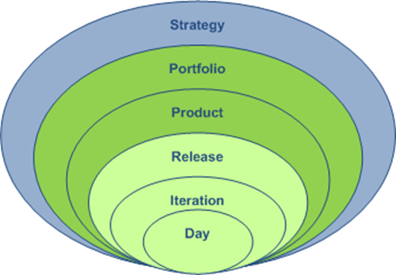
Planning Happens through Progressive Elaboration
Frequency | 1-2 times/year
Who | VTF & Executives
Focus | Product evolution over time
Frequency | 3-4 times/year
Who | VTF & Team
Focus | Tradeoffs between features & delivery date
Frequency | Every 2 weeks
Who | VTF requests & Team commits or counters
Focus | What user stories can be delivered within 2 weeks
Frequency | Every day (DTP)
Who | ATF & Team; VTF expected to attend
Focus | Commit to daily goals & identify impediments

Slide 38
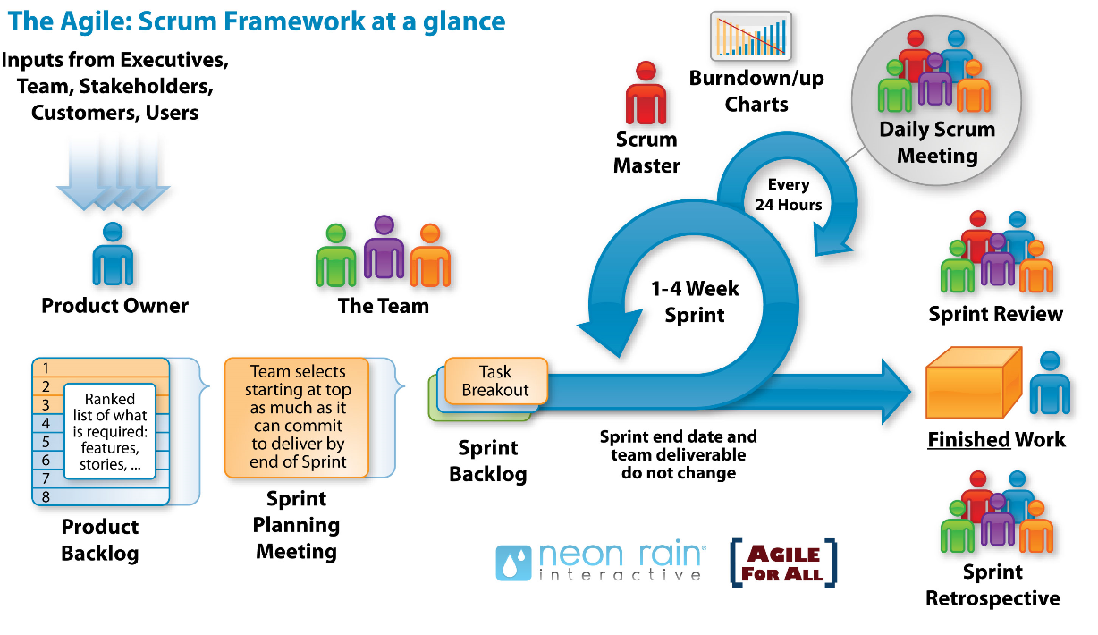

ATF Participation in the Agile Life Cycle
Daily Touch Point
Form Team & Chartering
Agile Team Facilitator (ATF)
Release Planning
2 week Iteration
Value Team Facilitator (VTF)
Value & Delivery Teams
Iteration Review
Iteration Backlog
Iteration end date and team deliverable do not change
Iteration Planning
Story Mapping & Grooming Backlog
ATF facilitates
VTF facilitates
Retrospective
Shared facilitation

Slide 39
Activities of an ATF
Meetings
Facilitating meetings for the team:
Preparing
Moderating
Post-processing
Each type of meeting has its own facilitation challenges and requirements
Team Dynamics
Coaching team members (e.g. with one-on-one coaching)
Mediating through conflicts
Helping the team to make decisions
Fostering the developer team’s self-organization
Mediating the general conflict of goals between development team (high technical quality) and product owner (more features)
Product
Helping to write or split user stories
Helping to write or adapt product visions
Helping to order product backlog items
Helping with the release planning
Being familiar with the team’s work (i.e. the product)

Slide 40
Activities of a ATF
Spanning the phases:
Model agility
Coordinate activities
Phase | Activities
Initiation | Identify members of the Delivery Team and create roster with names, locations, roles Participate with Value Team in developing Story Map and Product Backlog Provide input to Release Planning Plan chartering session with VTF Ensure the Delivery Team members have necessary training – See VES training resources
Iteration 0 | Co-facilitates the chartering session with VTF Participate in release planning (final release plan is a commitment from delivery team) With Value Team and Delivery Team representatives, completes grooming of enough of the Product Backlog (PB) to start Iteration 1
Iteration 1..n | Leads iteration planning Facilitates DTPs Help team maintain Information Radiators Plan and facilitate iteration reviews and demonstrations Facilitates retrospectives Removes impediments and shields the team from distractions
Pre-Release | Supports UAT and pre-release activities as needed

Slide 41
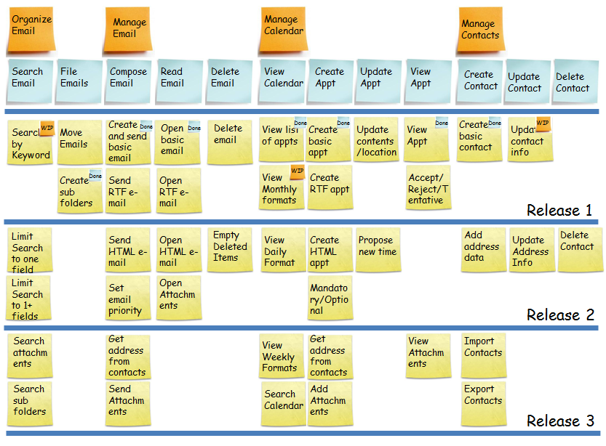
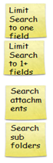


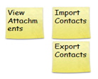

The Story Map
Epic
Feature
Stories
Verb / noun pairs
Notes:
At the funnel level what we care about is if dependencies have been defined and there is a plan to complete the dependencies so that features don’t get hung up. It is expensive to build partial features (Lean concept of WIP being inventory = waste) and get work hung up in the system. We need a clear plan for scope for the next release

Slide 42

Writing User Stories Is Collaborative
Business Team
Define vision and reasons
Discuss what matters most
Discuss business risks
Delivery (IT) Team
Define what is possible technically
Discuss the biggest technical risks and dependencies
Collaboration maximizes everyone’s value contribution
To get started, only a small group of representatives from both sides is needed to establish the user stories for the Story Map

Slide 43

Facilitating Chartering
Know what is essential and not essential in Chartering
Create initial charters so that teams start with a shared context, product and team vision, and goals at all levels (individual, team, company)
Plan the Chartering session in advance together with the ATF
Avoid common pitfalls such as:
the absence of essential stakeholders
the business case being non-existent or goals not measurable
business people or key team members not engaged
Having awareness to the importance of team specific topics (e.g. definition of done, iteration length, times for recurring meetings) being defined by the actual team rather than management
For additional information: Interview: Hear colleagues' experiences Chartering | Chartering PPT example

Slide 44
Examples of Chartering Project Components
Title | Description | Value
Vision | Defines the purpose of the team or project. | Aligns the team on the value of the project thereby increasing buy-in and support.
Goals | Defines the specific outcomes the team or project is working towards. | Aligns the team on the overall outcome of the project thereby increasing buy-in and support.
Measures of Success | Defines how the team or project will be evaluated for effectiveness. | For the defined vision and scope of the project, these are the various ways to tell that the team has succeeded. These measures can be in terms of business results, functionality, budget, delivery date, or other project attributes.
Trade-Off Matrix | A tool used to communicate project priorities; e.g., schedule, cost, functionality, quality. What one attribute is fixed (i.e., cannot) change? What one attribute should not change? What attributes are negotiable? | By defining and agreeing to the projects priorities early and upfront, a team can be honest from the start and priorities are known in advance of any issues that may surface during the project.
Challenges / Roadblocks | Defines know issues, impediments, and risks up front. | Visibility of the challenge/roadblock to the whole team in advance of surprises in the future.
Definition of Done (Project) | Defines up front the team’s definition of when the project is considered done. | Team alignment on the completion point of the project.
Milestones | Defines upcoming milestones (dates) for the team and/or project. | Aligns and drives the team to common time bound goals and objectives.

Slide 45
What else should be considered?
Examples of Chartering Components About the Team
Title | Description | Value
Members of the Project Community / Availability | List of all team members participating on the team, in any capacity, and personal availability to the project. | Aligns team members together and demonstrates commitment to the project and accountability to be present (in mind and body!) Building a sense of team.
Values | Defines a core set of beliefs that will ground the team together and provide perspective and focus: e.g., honesty, respect, quality, fun, energized work, communication etc. | Promoting team spirit and builds trust and relationships within the team. Creates mutual regard for team members.
Information Radiators | Defines what information the team will radiate and how it will be displayed and shared. Defines who will be responsible for keeping the information current. | Establishes what the team believes is important information to be shared to achieve transparency and facilitate communication; creates accountability.
Working Agreement | Defines the specific rules or norms that the team chooses to adopt to assure their effectiveness. | Creates accountability of team members to each other; enforces good behavior; guides how to celebrate success; can help guide the team when dealing with difficult issues, making decisions, asking for help, escalating issues, etc.
Logistics | In addition to the Working Agreement, logistics can be defined as other working guidelines that the team agrees to. Can include, for example, days and time for retrospectives, daily touch points, etc. | Ground rules for meetings and attendance, work locations, etc.

Slide 46
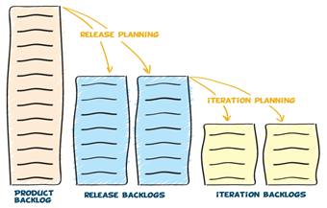
Release Planning
The VTF leads Release Planning together with (representatives of) the Delivery Team
One of the primary purposes of Release planning is to gain alignment between business owners and the program teams to a common, committed set of objectives.
Image credit: VersionOne - http://www.versionone.com/agile-101/agile-development-release-planning/

Slide 47
Story Map + Release = Release Roadmap
Epic
Feature
Stories
Notes:
At the funnel level what we care about is if dependencies have been defined and there is a plan to complete the dependencies so that features don’t get hung up. It is expensive to build partial features (Lean concept of WIP being inventory = waste) and get work hung up in the system. We need a clear plan for scope for the next release

Slide 48
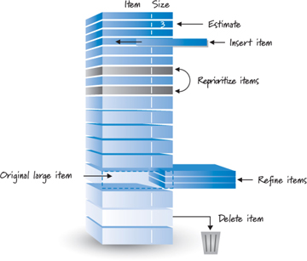
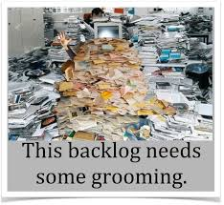
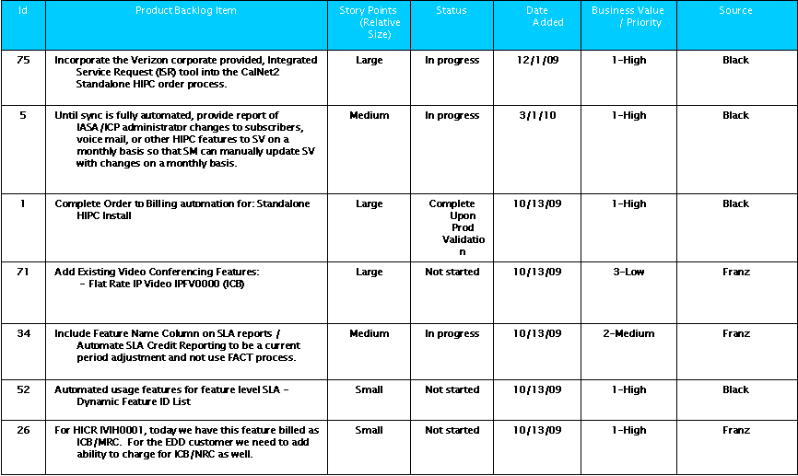
Grooming the Product Backlog
Backlog items are ‘User Stories’
Owned and prioritized by Value Team Facilitator
Grooming involves:
removing stories that no longer appear relevant
creating new user stories in response to newly discovered needs re-assessing the relative priority of stories
Identifying dependencies and risks
agree acceptance criteria are complete
assigning estimates to stories which have yet to receive one correcting estimates in light of newly discovered information
splitting user stories which are high priority but are too big to fit in an upcoming iteration
Product Backlog Template

Slide 49

Always Follow the Ready-Ready Rule
We do not want to let user stories into the iteration if they are not ready – that means “fully groomed”
We do not want to let stories out of the iteration if they are not ready – that means they meet the Definition of Done: they satisfy all of the acceptance criteria
“Fully groomed” means:
Prioritized
Adhering to the INVEST criteria
Include Acceptance Criteria
Dependencies identified
Estimated
Image credit: http://www.smalldogplace.com/images/shihtzu-with-curlers.jpg

Slide 50
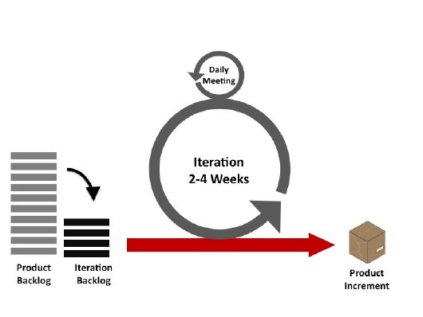
Iteration Planning
A meeting before an Iteration starts to identify the stories that will be implemented, and to break each of them down into specific technical tasks. The VTF & Delivery Team attends.
The result is an iteration backlog of stories, defects, tasks, and acceptance tests
The VTF presents the highest value stories they are considering for the iteration to the team
Each story is discussed to clarify its meaning and scope
Existing story estimates may be adjusted if during story clarification, new information comes to light that changes them significantly.
The team then accepts the stories they feel they can complete within the iteration
Iteration: 2 weeks

Slide 51
Parallel Activities During Iterations
Monday | Tuesday | Wednesday | Thursday | Friday
Iteration 0 |  | Iteration 1
 |  | Iteration 3 | Stabilization
Current Iteration Wrap Up
Iteration Review
Demo
Retrospective
Iteration 1
Iteration 2
Next Iteration Planning
Review the requested stories and confirm estimates
Create and estimate tech tasks
Accept stories into iteration based on capacity
Iteration 2
Iteration 3
Agile Core Team and Business Team are planning ahead 1-2 iterations
Notes:
Bob

Slide 52
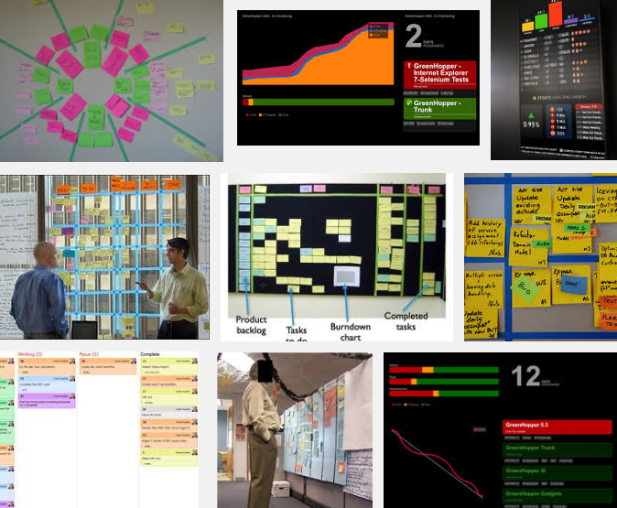
Information Radiators (IR)
The ATF engage to ensure the right IRs with the Delivery team
Every team member updates status...
What it is | The value of it
A display easily accessible highly visible keeps the team and stakeholders up to date | Agreement on what’s important is achieved & radiated Saved time by not having to search for status and info Avoidance of spending valuable time in status calls
…so the status in the IR is always current.
This is how the team manages its work.
Notes:
An information radiator is a large, highly visible display used by software development teams to track progress, it can also be referred to as a big visible chart. The term was first coined by Alistair Cockburn:
“An Information radiator is a display posted in a place where people can see it as they work or walk by. It shows readers information they care about without having to ask anyone a question. This means more communication with fewer interruptions."
Is large and easily visible to the casual, interested observer
Is understood at a glance
Changes periodically, so that it is worth visiting
Is easily kept up to date
Examples of use:
By VRD PMO:
The Online Dashboard
The Daily Breakfast Report
Self-subscribed and self-managed lists with reports; e.g. , for BREQs, commitments, status, code freeze, order enablement.
By PM:
Summary report in a spreadsheet.
Have a shared site where project log is kept, incl. action items, risks, etc. where also the customer can see what’s going on.

Slide 53
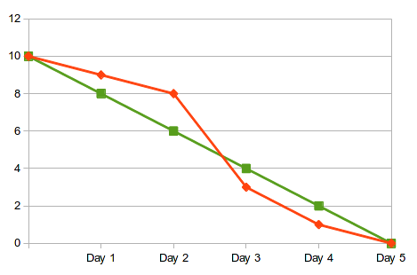
An Example of an IR:
Burn Down vs. Burn Up Charts
VTFs and the Delivery Team uses the Burn Down/Burn Up charts to status the work progress
Burn Down Chart example
Burn Up Chart example
How much work remains to be completed?
How much work has been completed against the scope?

Slide 54

Daily Touch Points (DTP)
Time-boxed – 15 min – meeting to commit to the day’s actions
Teams have regularly scheduled time
Commitment to time boxing
Value delivered meeting
Take problems off-line to be solved
Establish daily goals
Value Team Facilitator attends the DTP to keep current and answer questions
On large projects, there might be multiple DTPs with different subsets of the team
When the VTF cannot be in 2 places once, the team must coordinate information ☺

Slide 55
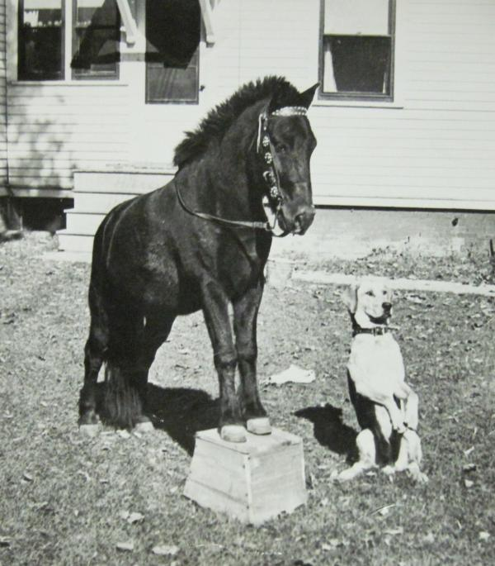
The ATF Plans & Participates in Iteration Review & Demo
Iteration Review
Review the Iteration Backlog and work completed in the iteration
Incomplete work remains on backlog to be prioritized by VTF. Does it need a new user story?
Demo
After each iteration
The Delivery Team demonstrates stories in the most realistic environment available
Validate & Verify
1st: Validation – Did the team build the right thing?
2nd: Verification – Did the team build the thing right?
The ATF ensures that all completed work is available for demo, that the demo is well planned, tells a story, & that data configurations are set up.
Feedback
VTF provides actionable feedback at the demo on iteration deliverable
The Delivery Team must not act defensively to the feedback
The Demo is the Delivery Team’s most potent tool for getting feedback & earning trust
Notes:
Bob

Slide 56

Retrospectives
Teams should ‘own’ their processes
Inspect the process – continually improve it
Do this at the end of an iteration via Retrospectives
Retrospectives are Delivery Team learning events
Need to create a safe environment
Consider a confidentiality agreement
What are we doing well (and should continue)?
What might we improve?
Align on 1 (or 2 at the max) things to change going forward
The VTF participates whenever appropriate
Agile Retrospectives: Making Good Teams Great
Ester Derby and Diana Larsen
Notes:
Bob

Slide 57
Agile Practices
Patterns & Anti-Patterns
Activity

Slide 58

Introducing Patterns & Anti-Patterns
The Agile Maturity Guide - Detailing each levels’ agile patterns and anti-patterns
 | Anti-Patterns (Less Agile) | Patterns (More Agile)
Values | Process and tools over individuals and interactions | Individuals and interactions over process and tools
 | Comprehensive documentation over working software | Working software over comprehensive documentation
 | Contract (e.g., requirements) negotiation over customer (BIZ & IT) collaboration | Customer collaboration over contract negotiation
 | Following a plan over responding to change | Responding to change over following a plan
 | Adopting agile practices without the mindset (or understanding why) – this yields the same results as before | Being able to apply advanced practices successfully requires the experience of collaborating effectively and inspecting and adapting
 | Creating “big plans” (e.g., project, requirements, design) at the start; plan the work and work the plan | Light-weight plans that expect things will change as we learn more over time
 | Delivering the value at the end | Delivering value incrementally

Slide 59
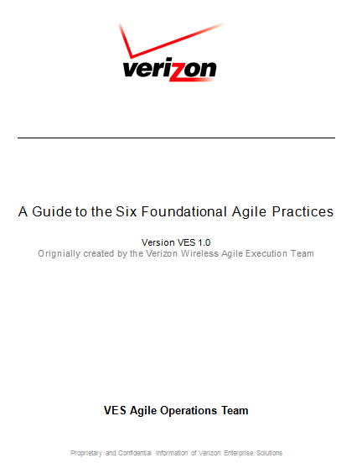
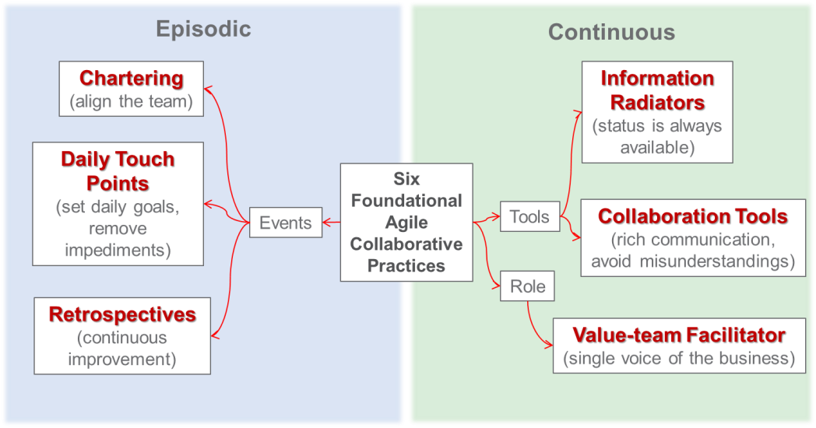
A Guide to the Six Foundational Agile Practices
To show others the Six Foundational Practices – click here
For further details and support Guide to the Six Foundational Agile Practices – click here

Slide 60
Activity – Agile Practices: Patterns & Anti-Patterns
Patterns: things we want to encourage – what are the smells of a successful practice?
Anti-patterns: things we want to discourage – what are the smells of a practice gone wrong?
5 minutes – set up
Self-organize into teams
Each team will pick a an agile practice (see below)
20 minutes – brainstorm/research
Each team will brainstorm/research to describe their practice
Emphasize the ATF role; what should the ATF consider and act upon
Describe some patterns and anti-patterns for the practice you picked
Debrief
Highlight team’s discoveries.
The two teams with the same practice will merge and collaborate to develop a presentation to give to the class
Practices
Chartering
Release Planning
Iteration Planning
Grooming the Backlog
Retrospectives
Demonstrations
Notes:
Chartering
Story Mapping
User Stories
Grooming the Product Backlog
Release Planning
Iteration Planning
Demo & Feedback
UAT
Burn up/down Charts – Measures
Forming a team
Iteration Planning
Daily Touch Points
Go/No-go Decision for production
Managing the Iteration Backlog

Slide 61
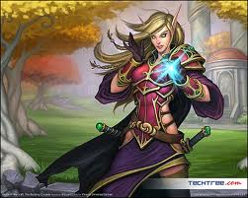
Words of Wisdom from a Pro
Laura Agan, ATF in VES

Slide 62


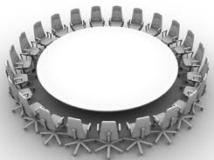
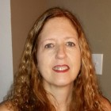
What’s It Like to Be a ATF?
Laura Agan shares her experiences
+
Open Q&A
Which is the real Laura;-)?

Slide 63
Agile Practices
Team Debrief

Slide 64
Debrief – Agile Practices: Patterns & Anti-Patterns
Patterns: things we want to encourage – what are the smells of a successful practice?
Anti-patterns: things we want to discourage – what are the smells of a practice gone wrong?
Each team presents their findings to the class
10 minutes per team

Slide 65
Wrap Up
Next Steps & Resources

Slide 66

The To-Go Box
Hungry for more?
Watch:
Jay Vogt: The Art of Facilitation: Changing the Way the World Meets – A TEDx Talk (18 minutes)
A Conference Call in Real Life – On YouTube (4 minutes)
Agile Product Ownership in a Nutshell (16 minutes)
Read about ICAgile’s certification for Agile Team Facilitation
Check out agile practices at: http://guide.agilealliance.org/
Continue the conversation via our new Chatter group:
The VES Agile Exchange
Notes:
https://na12.salesforce.com/_ui/core/chatter/groups/GroupProfilePage?g=0F9U00000009RAn

Slide 67
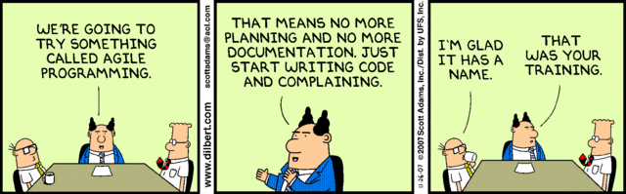
Put Your Knowledge Into Practice

Slide 69
Appendix
Resources

Slide 70
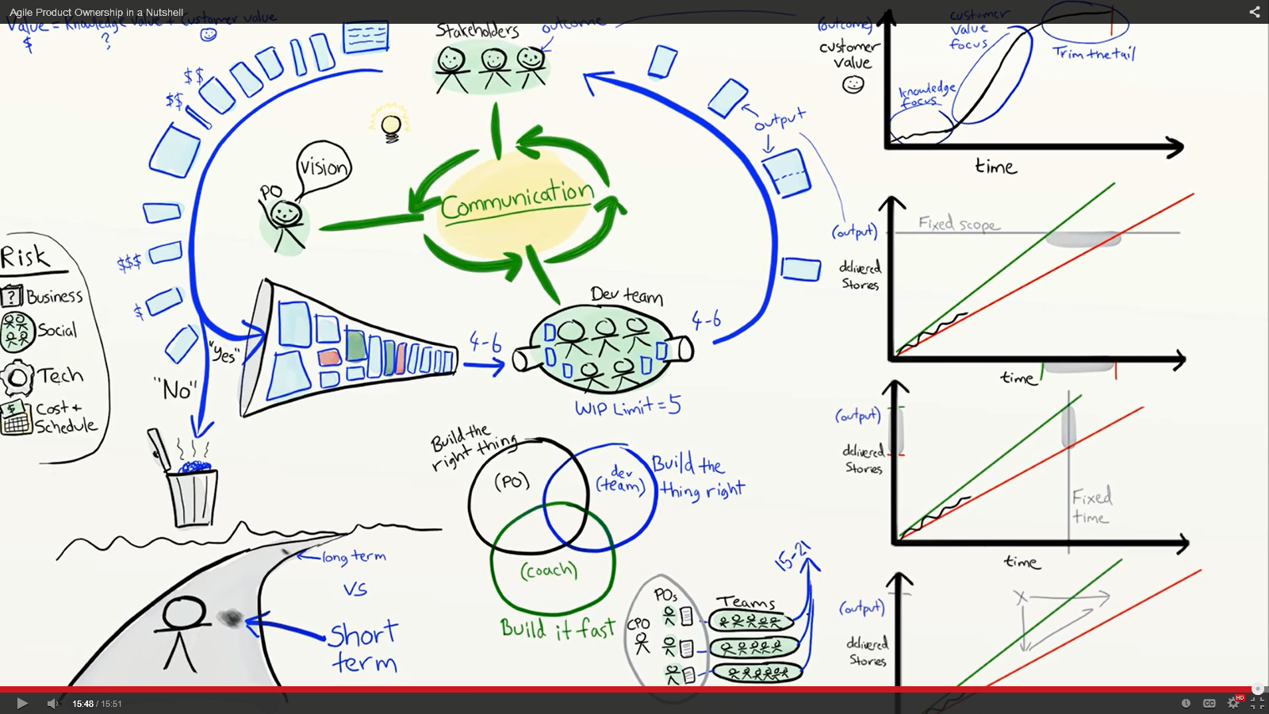
Agile Product Owner in a Nutshell
Play video on YouTube by Henrik Kniberg of Spotify
Notes:
Estimating the value and cost of stories is difficult – that is why we need collaboration between the value team and development team.
One of the most important responsibilities of the VTF is to say “No” so that the product backlog does not get clogged
Why is managing work in progress (WIP) so important?
In the Venn diagram – build the right thing – build the thing right – build it fast, where do you see your teams’ emphasis? What would you want to change?

Slide 71
Further Self-Paced Training, Cont’d.
For Agile Team Members
User Story Training | VZE37929 | 1 hr.
Agile Programming and Testing | SKL43481 | 1 1/2 hr.
Planning an Agile Software Development Project | SKL43471 | 2 hrs.
Agile Planning: Doing Estimates and Completing the Release Plan | SKL41221 | 2 hrs.
For Agile Value Team Facilitators | Product Managers | Team Leads | Project Managers | Development Managers | Team Leads | (VTF) | Agile Team Facilitators (ATF)
User Story Training | VZE37929 | 1 hr.
Agile Project Management Essentials | SKL41203 | 1 1/2 hr.
Leading an Agile Team AND/ OR: Introduction to Agile Project Management | SKL41230 / SKL43182 | 2 hrs. / 6 hrs.
Managing Agile Software Development | SKL43472 | 1 1/2 hr.
Agile Planning: Project Initiating and Requirements Gathering | SKL41220 | 2 hrs.
Managing Stakeholder Engagement on an Agile Project | SKL41240 | 2 hrs.
Planning and Monitoring Iterations on an Agile Project | SKL41229 | 2 hrs.
For descriptions and student ratings of these courses, see Appendix.

Slide 72

The Agile Café
The Agile Café is an informal webinar typically focusing on a single agile topic or a theme each session. Most importantly, this is a forum for VES agile practitioners to share their experiences and network.
The café is open the first week of the month on:
- Thursdays at 7:30a Eastern (GMT-05:00) - For bridge and Webex info, check the Calendar.
- Fridays at 2:00p Eastern (GMT-05:00) - For bridge and Webex info, check the Calendar.
Save the Date - Click on the calendar invite to save it into your Outlook schedule
Note that in some instances, the Calendar save feature converts the time - Please make sure that you get the times stated above! (Fridays repeat Thursday's topic.)

Slide 73
Professional Development Resources
Facilitation
Agile Team Facilitation Learning Objectives
Self-Assessment
Individual Development Plan
Coaching
Agile Coaching Learning Objectives (from ICAgile)
Self-Assessment
Individual Development Plan
Certification
VES Agile Coaches Readiness Checklist

Slide 74
Defining Roles & Responsibilities
A RACI Matrix is a tool for defining roles and responsibilities.
R | Responsible | Those who do the work to achieve the task. There is at least one role with a participation type of responsible, although others can be delegated to assist in the work required.
A | Accountable / Approve | The one ultimately answerable for the correct and thorough completion of the deliverable or task, and the one who delegates the work to those responsible. An accountable must sign off (approve) work that responsible provides There must be only one accountable specified for each task or deliverable
C | Consulted | Those whose opinions are sought, typically subject matter experts; and with whom there is two-way communication
I | Informed | Those who are kept up-to-date on progress, often only on completion of the task or deliverable; and with whom there is just one-way communication.
https://cloudsites.vzbi.com/sites/agileresources/CoP%20Files/Agile%20Roles%20and%20Responsibilities.pptx

Slide 75
Agile Practices Responsibilities
Practice | Responsible | Accountable | Consulted | Informed
Form a team | VTF and ATF | VTF Director / Tower Sponsor | SMEs | Leadership
Chartering | VTF ATF Project team members | VTF or ATF | Other stakeholders | All stakeholders via IRs
Establish & set up Collaboration Tools | Project Team | ATF | Tech. Representative | All stakeholders
Story Mapping | Agile Core Team | VTF | SMEs Enterprise Release Management | All stakeholders via IRs
Grooming the Product Backlog (incl. writing user stories, acceptance criteria, and estimation) | Agile Core Team Delivery Team | VTF | SMEs | All stakeholders via IRs
Release Planning & Road Mapping | Agile Core Team | VTF | SMEs Enterprise Release Management | All stakeholders via IRs

Slide 76
Agile Practices Responsibilities, Cont’d.
Practice | Responsible | Accountable | Consulted | Informed
Iteration Planning (Incl. Velocity, Capacity) | ATF/VTF Delivery Team | ATF/VTF | SMEs | All stakeholders via IRs
The Iteration - Managing the Iteration Backlog | Delivery Team | ATF | VTF | All stakeholders via IRs
Daily Touch Point (DTP) | Delivery Team Value Team Agile Core Team | ATF VTF VTF |  | All stakeholders via IRs
Information Radiators (IRs) | Delivery Team Value Team | ATF VTF |  | All team members and stakeholders
Concurrent engineering | Architects Business analysts Developers Testers | ATF | VTF SMEs | All stakeholders via IRs
Continuous testing | System testers UAT testers | ATF | SMEs | All stakeholders via IRs
Demo and Feedback | Delivery Team Value Team | VTF | Value Team Stakeholders | All stakeholders via IRs
Retrospectives | Delivery Team or Project Team | ATF |  | All stakeholders via IRs
UAT | UAT testers | VTF | Value Team Delivery Team | All stakeholders via IRs
Go/No-go decision for production | VTF | IT Director | Value Team Delivery Team | All stakeholders via IRs

Slide 77
ATF FAQ
I am not familiar with the requirements and technology on the team I am asked to coach, is that a problem?
No. Agile coaches bring process and performance expertise onto the teams. They are not functional SMEs (subject matter experts) on the team’s work product. Coaches use the Agile Principle of building projects around motivated individuals: give them the environment they need and trust them to get the job done. Agile coaches bring attention to Agile Values and Principles and the Practices that can help the team achieve high performance and throughput.
How can I influence the team to achieve High Performance?
As the team coach, you spend your time in team meetings listening to members’ interactions. Your participation is limited to speaking aloud observations about participation in light of agility – “catching” team members doing well with agile values and principles. You also find appropriate opportunities to discuss those observations that may have an opportunity to change to give the team dynamics closer alignment to agile values and principles.

Slide 78
ATF FAQ, Cont’d.
How will I know when to participate aloud?
Agile training is very specific with its guidelines of when to observe, when to coach and when to teach. Agile methods, while transparent is also very disciplined in those ways.
What if my observations are not influencing the team to be more Agile?
Sometimes the agile coach needs to motivate the team and help the members build trust and rapport in order to help create an environment that is safe for the members to practice agile. Another significant role of an agile coach is to listen to / learn from the team members to identify their learning styles and to facilitate team building exercises and discussions which bring awareness to the value each member brings to the team in order to help ease agile adoption. Also, going beyond observations, the agile coach interjects leading and powerful questions at appropriate times to trigger “ah hah” realizations by the team members to help them identify themselves opportunities to become more agile in their communications and actions.

Slide 79
Anatomy of an ETMS Iteration
CODE FREEZE
Skillset/ Role on team | Day 1 | Day 2 | Day 3 | Day 4 | Day 5 | Day 6 | Day 7 | Day 8 | Day 9 | Day 10
All including value team | Iteration Planning Meeting, Declare Stories ‘ready for iteration’ | Ideate, Design | Ideate, Design | Ideate, Design | Ideate, Design | Test | Test | Test, | Test, Determine if any stories not ready to deploy | Final Demo, Retrospective, Production Ready!
Developer | Define Tasks | Code, Build Junit Tests | Code, Refactor, Test | Code, Refactor, Test | Code/fix, Test | Code/fix, Test | Code/fix, Test, Look-ahead questions? Code Reviews | Fix, Test Look-ahead questions? Code Reviews | Fix, Test Look-ahead questions? Code Reviews | Demo Look-ahead questions?
Tester | Define Tasks Review Acceptance Test Criteria | Review Acceptance Test Criteria | Review Acceptance Test Criteria | Test | Test | Test, Build QA Automations | Test, Build/Run QA Automations | Test, Build/Run QA Automations | Test, Build/Run QA Automations | Run QA Automations, Demo
VTF Proxy / VTF | Present User Stories for the current Iteration at Iteration Planning | Refine Backlog, Analysis, User Interaction, Clarifications | Refine Backlog, Analysis, User Interaction, Clarifications | Refine Backlog, Analysis, User Interaction, Clarifications | Refine Backlog, Analysis, User Interaction, Clarifications | Facilitate Look-Ahead Meeting | Refine Backlog, Analysis, User Interaction, Clarifications | Refine Backlog, Analysis, User Interaction, | Refine Backlog, Analysis, User Interaction, | Confirm Production Ready, Facilitates Demo
ATF | Facilitates Iteration Planning meeting, Agile Coaching | Facilitates daily standup, Report on progress, Agile Coaching | Facilitates daily standup, Report on progress, Agile Coaching | Facilitates daily standup, Report on progress, Agile Coaching | Facilitates daily standup, Report on progress, Agile Coaching | Facilitates daily standup, Report on progress, Agile Coaching | Facilitates daily standup, Report on progress, Agile Coaching | Facilitates daily standup, Report on progress, Agile Coaching | Facilitates daily standup, Report on progress, Agile Coaching | Facilitate Retrospective,
CODE FREEZE
Notes:
Potential issues:
Few items or none are completed inside the iteration.
Reduce the work in progress. Do not commit to doing more than you can do in a iteration.
Developer testing not align with QA team testing.
Define you Acceptance Test Criteria Scenarios. Together DEV + VTF + QA.
Iteration planning “on Friday”? VDSI friends need stories to work on the next Monday.
People usually think of planning the weekend. Philological speaking a Friday is not the best day for a long planning meeting. Then, you also have Retrospective + Review.
We need Automation Test inside the iteration
At least for the most critical changes or for the ones that impact on the most critical flows.
Are we developing new functionality the last 2 days of the Iteration?
We need a code Freeze and stability phase inside the iteration. Also, QA will need to run with the testing on the last day trying to complete the User Story.

